Slide 1
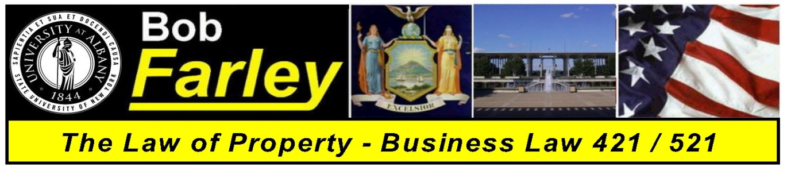

Slide Set Six:
Personal Property III
Gifts

Slide 2

Last Time – We Spoke About:
Part One: A Continuation of Exercising Rights in Personal Property – Including:
- Liens and Security Interests
for Personal Property

Slide 3
Tonight – We will speak about:
Part One: Gifts
  Fundamental Principles.
    Gift Intervivos
      Unconditional Gifts
      Gifts in Consideration of Marriage
    Gift Causa Mortis

Slide 4
Part One:
Gifts

Slide 5
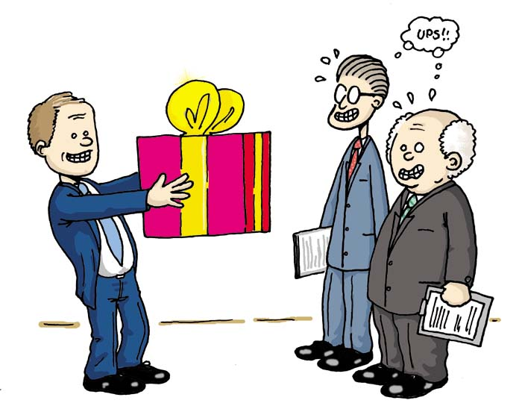
Part One: Personal Property – The Law of Gifts
The Wonderful World of GIFTS
GIFTS
Types of Gifts
Gifts Inter Vivos
(Gifts During Lifetime)
Gifts Causa Mortis
(Gifts in Contemplation of Death)
The Three Factors that make a Gift
a. Donor's Intent
b. Delivery
c. Acceptance

Slide 6
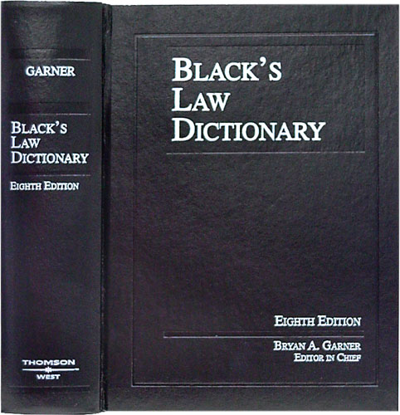
Part One: Personal Property – The Law of Gifts
The Wonderful World of GIFTS
GIFTS
Defined
Our old friend Black’s Law Dictionary
defines a Gift as:
“A voluntary transfer of
property to another
made gratuitously
and without consideration”

Slide 7
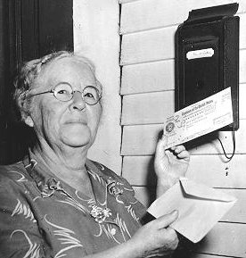
Part One: Personal Property – The Law of Gifts
The Wonderful World of GIFTS
GIFTS
When it comes to gifts
remember your dear Aunt IDA
The Three Factors
that make a Gift
a. Donor's Intent
b. Delivery
c. Acceptance

Slide 8
Part One: Personal Property – The Law of Gifts
The Wonderful World of GIFTS
1. Inter Vivos Gifts
a. Donor's Intent
The donor must intend to make an immediate gift.
Mere Delivery is NOT evidence of Intent
Intent must be proven by “clear and convincing evidence” if the gift is challenged.
Courts are suspicious of “claimed gifts”.
Facts determine if donor had requisite Intent, and the donee bears the burden of proof to show that such Intent exisited.

Slide 9
Part One: Personal Property – The Law of Gifts
The Wonderful World of GIFTS
Inter Vivos Gifts (Continued)
b. Delivery
The validity of an inter vivos gift depends on the property’s delivery to the donee.
A simple promise to give does not complete the gift.
Delivery must be established by "clear and convincing evidence".
A declaration by a bailor to the bailee that the bailed article is a gift has the effect of immediately transferring title.
Thus, a note by decedent saying, "I am giving my diamond rings to X," was held to be a mere statement of present intent, insufficient to prove the act of delivery.

Slide 10
Part One: Personal Property – The Law of Gifts
The Wonderful World of GIFTS
Inter Vivos Gifts (Continued)
b. Delivery (Continued)
1) Gifts of Checks, Notes or Stock Certificates
There are two specific rules of delivery to remember for gifts of checks or notes:
a) If the donor is the drawer or maker of the check or note, delivery is not valid
until the check or note is cashed.
b) If the donor is giving someone else's check or note, then delivery is valid when
the check or note is given, even without a valid endorsement.
A stock certificate is validly delivered when given, even without endorsement.
2) Gifts Through Agent
If a gift is given through an agent, the time when the delivery requirement is satisfied depends on whose agent the agent is.
a) If he is the donor's agent, the gift is not delivered until given to the donee.
b) If he is the donee's agent, the gift is delivered when given to the agent.
c) Where there is doubt about whose agent is being used, the presumption is:
- If the donee is a minor, the agent is the donee's;
- If the donee is not a minor, the agent is presumed to be the donor's.
3) Joint Checking Account
In New York, the survivor of a joint account will automatically become the owner of the account (absent fraud, undue influence, mental incapacity, or mistake).
Some other jurisdictions allow a rebuttable presumption to be raised in the case of a joint checking account (our state does not).

Slide 11
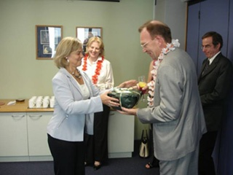
Part One: Personal Property – The Law of Gifts
The Wonderful World of GIFTS
Inter Vivos Gifts (Continued)
c. Acceptance
Acceptance of the gift by the donee
is also a critical element in a valid
inter vivos transfer.
Acceptance of the gift is ordinarily
presumed; (i.e., rejection of a gift
requires manifestation of that intent
by word or conduct.)
However, joint control by the putative
donor and donee negates the gift.

Slide 12
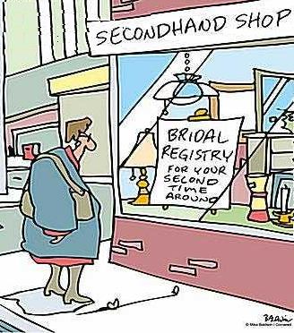
Part One: Personal Property – The Law of Gifts
The Wonderful World of GIFTS
Inter Vivos Gifts (Continued)
Special Circumstances :
Gifts in Contemplation of Marriage
Engagement gifts (e.g., a diamond engagement
ring) are made in contemplation of marriage and
are conditioned upon the subsequent ceremonial
marriage taking place.
If the marriage DOES NOT occur, engagement
gifts must be returned regardless of who is
at fault for breaking off the engagement.
The donor may recover gift even if donor is at fault.

Slide 13
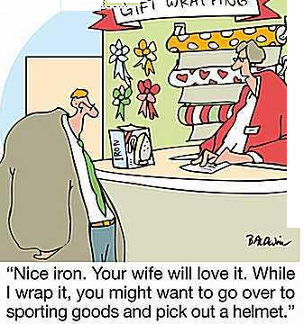
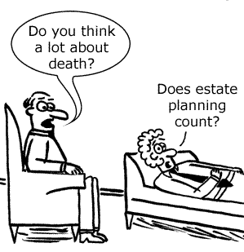
Part One: Personal Property – The Law of Gifts
The Wonderful World of GIFTS
2. Gifts Causa Mortis
a. Gifts of Personal Property Only
Only personal property may be transferred as a gift causa mortis.
b. Delivery and Acceptance
Delivery and acceptance must be sufficient to vest dominion and
control in the donee.
Delivery to an agent does not complete the gift, since death is
an event that terminates the agency.
c. Connection Between the Gift and the Donor's Fear of Death
At the time of the gift, the donor must have an immediate
and present fear of death.
However, the actual cause of the death need not necessarily
be the specific one the donor feared (i.e.• donor hospitalized
for cancer, but dies of stroke).
A gift causa mortis is revocable and is automatically revoked
by the donor's recovery or by the donee's death.

Slide 14
Part One: Personal Property – The Law of Gifts
The Wonderful World of GIFTS
3. Gifts Cancelled by Fraud
Generally
Fraud vitiates all contracts and generally is not presumed but must be proved by the party seeking to relieve himself from an obligation on that ground.
However, the burden is shifted and the transaction is presumed void when it is virtually certain that the parties did not deal on equal terms because of an abuse of a fiduciary relationship or an overmastering influence by one party.
In such situations, the "stronger party" must show that no deception was practiced, that no undue influence was used, and that all was fair, open, voluntary, and well understood.

Slide 15
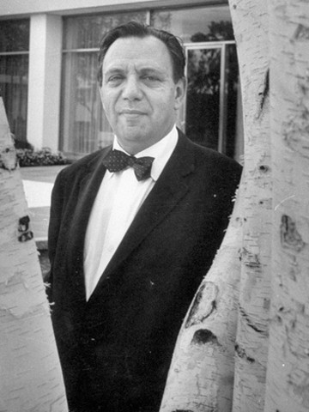
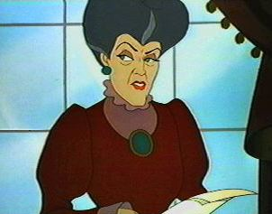
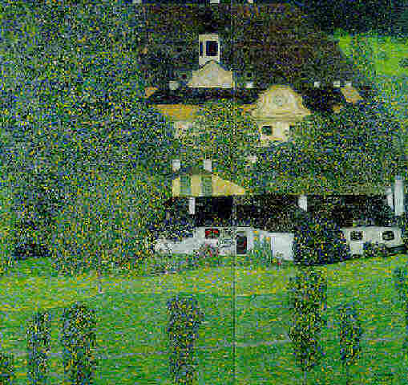
A Venture into the Case Law of Gifts
The Case of Gruen v. Gruen
Victor Gruen Kemija Gruen The Painting: Schloss Kammer II
The Father, the Son, the Step Mother and the Painting!

Slide 16
Final Thoughts
Bonus Question of the Day
For next time – Read Assignments on the Webpage.
We are a hot bench.
Questions???

