Slide 1
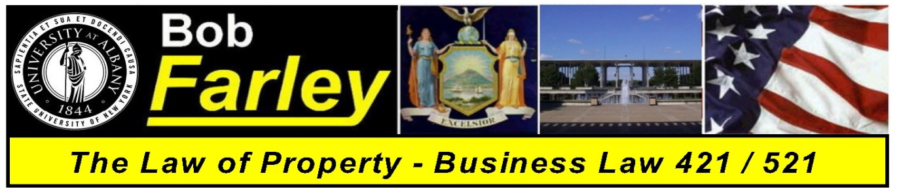

Slide Set Fourteen:
Real Property: Interests in Land – Time, Possession,
Future Interests and Title Limitation Rules

Slide 2

Last Class:
We will begin to discuss Real Property Concepts
- Real Property – The Basics
- Definitions of Real Property
- The Importance of Real Property
- Nature of Interests in Real Property
- Possessory Estates vs. Non Possessory
- Estates in Time – Duration of Rights
- Collection of Rights
- Shared Rights in Land
- Real Property Taxes

Slide 3
Tonight’s Class:
We Will Discuss:
- The Nature, Definitions and Explanation of Estates in Land
Possessory Interests in Land
1. Fee Simple Absolute
2. Defeasible Estates
3. Fee Tail
4. Life Estate
Non possessory interests in land:
1. Easements, 2. Profits, 3. Covenants, and 4. Servitudes
- Future Interests
Future Interests - Estates in Time
1. Life Estates, 2. Possibility of Reverters, and 3. Rights of Re-Entry
- Title Limitation Rules
- Rule in Shelley’s Case
- Doctrine of Worthier Title
- Rule Against Perpetuities
- Rule Against Restraints on Alienation

Slide 4
Real Property – A Review of the Basics
- Real Property is very Important and Valuable
  Real Property has historically meant Wealth, Power and Life
  To truly understand Real Property, and its importance and value, we need to think in terms of Possession and Time
  The concepts of Ownership and Limitations on Ownership are fundamental for an understanding of Real Property, because of its importance and value.
  The value of Real Property has led to complex legal rules
  Fee Ownership – Estates in Land – is the foundational platform for real property.
  Because of its value, the law has recognized Concurrent Property Ownership, and authorizes Real Property Taxes

Slide 5
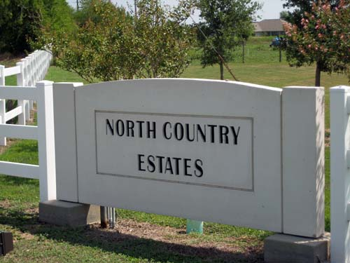
First: The Nature of Interests in Real Property
Estates in Land

Slide 6
Estates in Land
So just what is an Estate in Land?
An Estate in land is an “Interest in Land”
that relates to your Collection of Rights
with respect to the Real Property in question.
Real Property has always been held as:
- Valuable,
- Special,
- Distinct, and
- Unique,
under the law.
Accordingly, the law has long recognized that Rights
in such Real Property are to be viewed
as Extensive and Severable, and as such,
can also be limited in its Transference, by the original owner.

Slide 7
Estates in Land
So just what is an Estate in Land?
When you have an ownership interest in the land,
you maintain a Collection of Rights with respect
to the Real Property in question.
These Rights, and their Limitations,
of an Estate in Land, include:
  Exclusion
  Possession
  Use; and
  Transfer; as well as
  Time

Slide 8
Estates in Land
So just what is an Estate in Land?
To determine the rights and limitations conveyed,
in an Estate in Land, it is necessary to look at the
property rights in terms of:
  1. Titled Ownership, and
  2. Limitations Titled on Ownership
  The inherent value of Real Property
  has therefore led to complex legal rules
  to provide these rights and limitations
  and their conveyance.

Slide 9
Estates in Land
So just what is an Estate in Land?
A Two Step Dance: Possession and Time
(Two Major Questions – Must be asked to determine the Interest)
Step One: Form of Possession
(Possession – Does the interest allow possession of the realty?)
● Possessory Interests in Land (Either presently or in the future)
● Non - Possessory Interests in Land (Either presently or in the future)
Step Two: When the Interest Vests
● Present Interests (When the RIGHT to possess is NOW)
● Future interests (When the RIGHT to possess is in the future)

Slide 10
Types of Estates in Land
Possessory Interests in Land (Either presently or in the future)
1. Fee Simple Absolute
2. Defeasible Estates
- Fee Simple Determinable with Possibility of Reverter
- Fee Simple Subject to a Condition Precedent
- Fee Simple Subject to an Executory Interest
3. Fee Tail
4. Life Estate
Non possessory interests in land: (An Interest with a right that can be executed but is not presently possessed)
1. Easements
2. Profits,
3. Covenants, and
4. Servitudes

Slide 11
Estates in Land
What is the meaning of the term FEE??
● The term derives from English Common Law:
● Under Common Law, the King had radical title or “allodium”
over all English lands.
● Such title meant that the King was the ultimate "owner" of all Real Property.
● The King, could, however, grant an abstract entity
(known as an Estate in Land) to a subject.
● This Estate in Land would be effectively “owned and possessed”
by the subject granted the estate.
● The grant of the Estate in Land by the King was known as a Fee.
● The fee simple estate, also called "estate in fee simple" or "fee-simple title" is sometimes simply known or referred to as a ”freehold”

Slide 12
Estates in Land
What is the meaning of the term FEE?? Continued
● The term derives from English Common Law:
● In the early period after the Norman conquest,
the holder of an estate in fee simple could not sell it,
but instead could only grant a subordinate fee simple estate
to a third party in the same parcel of land –
this was a process known as “subinfeudation”
where the King still maintained ultimate ownership power over the land.
● The Statute of Quia Emptores, adopted by Parliament in 1290,
abolished subinfeudation and allowed the sale of fee simple estates.
● This was another offshoot of the Magna Carta 75 years earlier.
● Later William Blackstone, the great common law commentator,
would define land held in fee simple as:
      An estate in land held by the owners and their heirs absolutely;
      An estate in land without any end or limit;
      An estate in land can be conveyed to whomsoever the owner pleases;
      An estate in land can be mortgaged or put up as security; and
      An estate in land can be reduced to any other type of lesser estate.

Slide 13
Types of Estates in Land
Possessory Interests in Land (Either presently or in the future)
1. Fee Simple Absolute
2. Defeasible Estates
- Fee Simple Determinable with Possibility of Reverter
- Fee Simple Subject to a Condition Precedent
- Fee Simple Subject to an Executory Interest
3. Fee Tail
4. Life Estate
Non possessory interests in land: (An Interest with a right that can be executed but is not presently possessed)
1. Easements
2. Profits,
3. Covenants, and
4. Servitudes

Slide 14
Words of Purchase vs. Words of Limitation
● Today, we no longer have the ceremony of Livery of Seizen.
● Title to Real Property is conveyed by means of a written deed.
● As a result, to determine what rights exist in an Estate in Land, there are two factors in the deed which tell the story:
Words of purchase:
Describe who takes the real property
by grant, gift, inheritance or bequest.
Words of limitation:
Describe the type and duration of the estate taken by the transferee.

Slide 15
Estates in Land – Possessory Interests
Possessory Interests in Land
(Possessed either presently or in the future)
1. Fee Simple Absolute
2. Defeasible Estates
- Fee Simple Determinable with Possibility of Reverter
- Fee Simple Subject to a Condition Precedent
- Fee Simple Subject to an Executory Interest
3. Fee Tail
4. Life Estate

Slide 16
Estates in Land – Possessory Interests
What goes in the deed for words of purchase and words of limitation
● Present, possessory interest.
● Highest Level Estate in Land:
  FEE SIMPLE ABSOLUTE
  1. Invests the owner with all possible rights (E-PUT) now and in the future.
  2. It is the presumed form of ownership grant, unless a lesser estate grant was expressly intended.
  3. Is of perpetual and infinite duration (lasts forever).
  4. Is the form of ownership from which all lesser forms are derived.
  Magic Language: “To Grantee and their heirs”

Slide 17
Fee Simple Absolute
“To A and his heirs”
What are the words of purchase?
What are the words of limitation?
To A
Words of purchase
and his heirs
Words of limitation
Infinity

Slide 18
What are the critical attributes of
Fee Simple Absolute?
When a transfer is made to A and his heirs:
Alienable (Able to be sold/gifted),
Reducible (Able to be reduced to a lesser estate)
Devisable (Able to be given by will or intestate), and
Lasts for Perpetuity (Forever – No Limitation of Time).

Slide 19
Estates in Land – Possessory Interests
What goes in the deed for words of purchase and words of limitation
● Present, possessory interest.
● Next to Highest Level Estate in Land:
● Defeasible Estate:
- These are possessory fee estates of infinite duration
that can be terminated by the happening of a specified event.
- These are a lesser estate than fee simple absolute.
FEE SIMPLE DETERMINABLE (Possibility of Reverter)
1. An Estate that AUTOMATICALLY terminates upon the happening
of a stated event.
2. Stated event must be for a lawful purpose.
Magic Language: “To Grantee and their heirs
for so long as” or “while” or “during” or
“until” (the occurrence of an event).

Slide 20
Fee Simple Determinable
“To A and his heirs for so long as …”
What are the words of purchase?
What are the words of limitation?
and his heirs for so long as …
Words of limitation
To A
Words of purchase
Infinity

Slide 21
What are the critical attributes of
Fee Simple Determinable?
When a transfer is made to A and his heirs for so long as … :
All Subject to the Possibility of Reveter
Alienable (Able to be sold/gifted),
Reducible (Able to be reduced to a lesser estate)
Devisable (Able to be given by will or intestate), and
Lasts for “So Long As” (The Limitation of The Reverter).

Slide 22
Estates in Land – Possessory Interests
What goes in the deed for words of purchase and words of limitation
● Present, possessory interest.
● Next to Highest Level Estate in Land:
● Defeasible Estate:
- These are possessory fee estates of infinite duration
that can be terminated by the happening of a specified event.
- These are a lesser estate than fee simple absolute.
FEE SIMPLE SUBJECT TO A CONDITION SUBSEQUENT
An Estate that can terminate upon the happening
of a stated event and the taking of an action
by the party granted such rights by the transferring owner.
Known as a RIGHT OF RE-ENTRY, this termination is
NOT AUTOMATIC and needs the grantor to take action
Magic Language: “To Grantee and their heirs upon the condition that” or “provided that” or “but if” or “if it happens that” (the occurrence of an event).

Slide 23
Estates in Land – Possessory Interests
Defeasible Estates Continued
FEE SIMPLE SUBJECT TO A CONDITION SUBSEQUENT
- A RIGHT of RE-ENTRY CAN be waived
(unlike Fee Simple Determinable which is automatic)
by express agreement or by conduct.
- Although inaction by itself is NOT a waiver,
where there is inaction, and detrimental reliance,
courts have held a waiver by the grantor
pursuant to the doctrine of estoppel.
- The rights of a Fee Simple Subject to a Condition Subsequent have been held to be devisable, but NON TRANSFERABLE.

Slide 24
Fee Simple Subject to Condition Subsequent
“To A and his heirs upon the condition that …”
What are the words of purchase?
What are the words of limitation?
To A
Words of purchase
and his heirs upon the condition that …
Words of limitation
Infinity

Slide 25
What are the critical attributes of Fee Simple Subject to a Condition Subsequent?
When a transfer is made to A and his heirs upon the condition that … :
All Subject to the Right of Re-entry
Alienable (Able to be sold/gifted),
Reducible (Able to be reduced to a lesser estate)
Devisable (Able to be given by will or intestate), and
Lasts until the condition arises AND the Right of Re-entry is exercised.

Slide 26
Estates in Land – Possessory Interests
Defeasible Estates
FEE SIMPLE SUBJECT TO AN EXECUTORY INTEREST
- A Defeasible Estate that AUTOMATICALLY divests in favor of a THIRD PERSON upon the happening of a stated event.
- Different from a FEE SIMPLE DETERMINABLE in that this estate does not revert to the grantor but to a 3rd PERSON.
- Subject to the Rule Against Perpetuities.
- Title passes to a third party in the event that the Condition is satisfied.

Slide 27
Estates in Land – Possessory Interests
Defeasible Estates
  LIMITATIONS
  - Possibility of Reverters and Rights of Re-entry have been limited
  by most states to foster the marketability of title.
  A free society needs the ability to freely transfer property,
  and not impair the title of the same from transactions
  which occurred years ago.
  - DIRECT STATUTORY PRECLUSIONS (usually 30 years)
  - RULE AGAINST PERPETUITIES (21 years plus lives in being)
  - RULE IN SHELLEY’S CASE (Remainder limited to heirs or heirs of the body)
  - DOCTRINE OF WORTHIER TITLE (Remainder invalid, Grantor retains reversion)

Slide 28
Estates in Land – Possessory Interests
Present, Possessory Interests.
  FEE TAIL
1. An Estate limited to the grantee and his or her family
2. Reverts to grantor if not owned by heir
3. No longer recognized in almost any state
  Magic Language: “To Grantee and heirs of their body”
Now FEE SIMPLE ABSOLUTE

Slide 29
Estates in Land – Possessory Interests
Present, Possessory interests.
  LIFE ESTATE
1. By Marital Right (Dower and Curtsey)
2. For Life of Grantee
3. Pur Autre Vie (Life of Another)
Magic Language: “To Grantee for Life”
or
“To Grantee for the Life of Tilda Spain”

Slide 30
Life Estate
“To A for Life…”
What are the words of purchase?
What are the words of limitation?
To A
Words of purchase
for life…
Words of limitation
Infinity

Slide 31
Estates in Land – Non Possessory Interests
Until now we have discussed “Possessory Interests”,
meaning interests in real property
that either ARE, or WILL BE (pre-vested interests)
POSSESSED by the holder of the property.
Just as there are possessory interests in real property
where possession is not effectuated yet
because of time or condition,
the law also recognizes interests in real property
where the holder of such interest
does NOT EVER actually POSSESS the property.
Such are interests are deemed “Non - Possessory Interests”

Slide 32
Estates in Land – Non Possessory Interests
Non Possessory Interests
Easements
Profits
Covenants
Servitudes

Slide 33

Future Interests

Slide 34
Future Interests - Estates in Time
- Life Estates
The remainder is the estate in time.
- Possibility of Reverters
The reversion is the estate in time.
- Rights of Re-Entry
The right of re-entry is the estate in time.

Slide 35
Future Interests – Estates in Time
Like all property, interests in land are a collection of rights
Interests in Land need to be seen through the prism of:
  Possession
  Time
Two Major Questions
Possession – Does the interest allow possession of the realty?
Time – What time will the interest in the property be executed?
This time factor is the critical question
when dealing with “Future Interests”

Slide 36
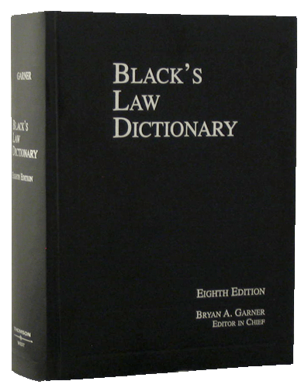
Future Interests – Estates in Time
Remember – We need to think of possession & time
Black’s Law Dictionary – Definition
Future Interests: “Interests in land or other things in which the privilege of possession or of enjoyment is future or non present.”
The real property rights that are left over from the granting of an interest

Slide 37
As a result …
Possessory Interests in Land
Can be:
Present Possessory Interests or
Future Interests

Slide 38
Estates in Land
So just how are Future Interests Determined?
A Two Step Dance: Possession and Time
(Two Major Questions – Must be asked to determine the Interest)
Step One: Form of Possession
(Possession – Does the interest allow possession of the realty?)
● Possessory Interests in Land (Either presently or in the future)
● Non - Possessory Interests in Land (Either presently or in the future)
Step Two: When the Interest Vests
● Present Interests (When the RIGHT to possess is NOW)
● Future interests (When the RIGHT to possess is in the future)

Slide 39
Types of Future Interests
Reversionary Interests
    Reversions
    Possibility of Reverter
    Right of Re-entry
Remainders

Slide 40
Explanations of Future Interests
Reversionary Interests
  Reversion
  The residue (or future interest) of an estate left by operation of law in the grantor or his heirs.
  Examples/Explanation:
  When any lesser estate is created from the fee simple absolute, the reversion is legal rights in the estate that the grantor or his heirs are entitled to after such creation, including remainders or executory interests, vesting in the grantor of his heirs. The key is that such legal interest RETURNS to the grantor or his heirs.

Slide 41
Explanations of Future Interests
Reversionary Interests
  Possibility of Reverter
  A specific type of reversion, pursuant to a fee simple determinable, whereby the estate AUTOMATICALLY returns to grantor of his heirs upon the happening of a stated, legal, event.
  Examples/Explanation:
  When a grantor transfers an estate to the grantee for so long as the property remains an active, cultivated farm, if the grantee stops using such property for such legal purpose, the parcel automatically reverts back to the grantor or his heirs.

Slide 42
Explanations of Future Interests
Reversionary Interests
  Right of Re-entry
  A specific type of reversion, pursuant to a fee simple subject to a condition subsequent, whereby the grantor or his heirs have a right to reclaim the estate upon the happening of a stated, legal, event.
  Examples/Explanation:
  When a grantor transfers an estate to the grantee upon the condition that the property remains an active, cultivated farm, if the grantee stops using such property for such legal purpose, then the grantor or his heirs can exercise a right to reclaim full title to the parcel.

Slide 43
Explanations of Future Interests
Remainders
  Remainder
  The remnant (or future interest) of an estate depending upon a particular prior estate created at the same time and by the same instrument, and limited to arise immediately on the determination of that estate, and not in abridgement of it. In other words, a remainder is a future interest limited in favor of a transferee, which may become possessory immediately upon the termination (upon the happening of a limitation) of a prior possessory estate simultaneously created
  Examples/Explanation:
  Those rights in an estate which are left over (i.e. that remain) from the creation of a lesser estate.

Slide 44
Explanations of Future Interests
Remainders
  Remainders v. Reversions
  Reversions are special remainders, whereby the remainder vests in the grantee or his heirs. As a result, all reversions are remainders, but NOT all remainders are reversions.
  Examples/Explanation:
  In the case of a reversion, the remainder is those rights in an estate which are left over (i.e. that remain) from the creation of a lesser estate and vest in the grantor of his heirs. In a remainder that is not a reversion, such is where such rights vest in another person who is NOT the grantor or his heirs.

Slide 45

Title Limitation Rules

Slide 46
Title Limitation Rules
Rule in Shelley’s Case
Doctrine of Worthier Title
Rule Against Perpetuities
Rule Against Restraints on Alienation
These Rules All Seek
to Promote Marketable Title
and Ensure that Real Property
is NOT Controlled for any significant time
from Beyond the Grave

Slide 47
RULE IN SHELLY’S CASE
Wolfe v. Shelley, 1 Co. Rep. 93b, 76 Eng. Rep. 206 (C.P.), generally known as Shelley's Case
In 1581 England, in an attempt to avoid inheritance taxes, land transactions were being structured:
To A for life, with a remainder to A’s heirs
Seeing through this legal fiction, the court held that since A could control the disposition of his estate (i.e. who would be his heirs), that any such transfer was really, and should be deemed to be:
Now: To A in Fee Simple Absolute.

Slide 48
The Rule in Shelley’s Case
As a Result:
If a life estate is created in A and a remainder is created in A’s heirs, the remainder is deemed to have been created in A rather than A’s heirs.
Now with the Rule in Shelley’s Case, A would have a life estate and the next vested estate, and they would merge to give A a fee simple absolute in the property.
Reasons for the rule?
- Promote marketable title
- End a legal fiction tax dodge

Slide 49
Doctrine of Worthier Title
(Similar to Rule in Shelley’s Case, but with different parties)
Again in Common Law England, in an attempt to avoid inheritance taxes, land transactions were being structured:
To A for life, with a remainder to O’s heirs
Seeing through this legal fiction, the courts held that since O could control the disposition of his estate (i.e. who would be his heirs), that any such transfer was really, and should be deemed to be:
Now: To A for Life, with a Reversion to O.

Slide 50
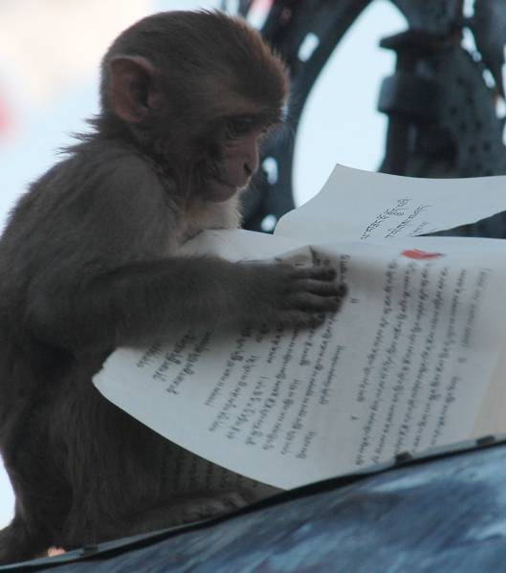
Rule Against Perpetuities
The Rule Against Perpetuities
is one of the most complicated
Rules in the Law.
Basically, common law disfavors and prevents property from being held perpetually in trust.

Slide 51
The Rule Against Perpetuities
Statement of the Rule:
Any agreement
with respect to the transfer of property
(reversions, remainder, ect.) is VOID
which does not end
twenty-one (21) years after
a life in being at the time of the transfer
(i.e. one generation from lives presently in being - twenty-one years.)

Slide 52
Rule Against Perpetuities
Another way to describe this is:
"No property interest
shall be deemed valid
unless it vests, if at all,
not later than 21 years
after some life in being
at the time of the creation of the interest.“
An interest is "vested" when we know for sure
that someone will receive, or fail to receive, the interest.

Slide 53
The Rule Against Perpetuities
Explained:
This 21 years (which represents a generation) is an arbitrary time period merely intended as a breaker for the entanglement to estates and their title, so as to return such estates back to the preferred title of fee simple absolute.

Slide 54
The Rule Against Perpetuities
Pursuant to this Rule “lives in being” include:
The holder of the interest;
The person creating the interest;
Any person who can affect a condition precedent attached to the interest; and
Any person who can affect the identify of the holder
It should be noted that unborn babies, if born alive, are considered “lives in being”

Slide 55
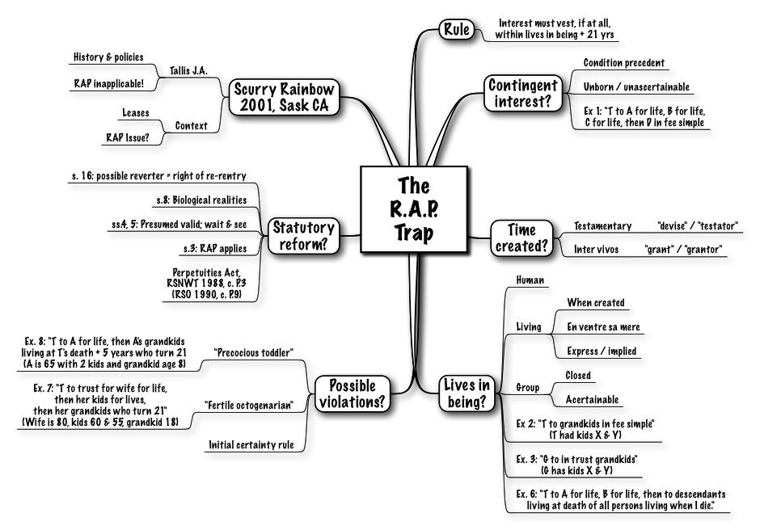
The Rule Against Perpetuities

Slide 56
Rule Against Restraints on Alienation
This Rule was established and recognized under Common Law. It stated that:
“Any restriction on the transferability
of a legal (as distinguished from an equitable)
interest in property
is, and shall be deemed as, void.”
A “Restraint on Alienation" means an express restriction on the future transferability of the real property.
Like the Rule Against Perpetuities, this is a Rule
of public policy, that is designed to encourage
the marketability of title, and prevent real property
from being tied up and taken out of commerce.

Slide 57
Rule Against Restraints on Alienation
There are three types of restraints on alienation:
1. Disabling restraints, which prohibit any future transfer;
2. Forfeiture restraints, under which an attempted transfer results in a forfeiture of the interest; and
3. Promissory restraints, under which an attempted transfer breaches a covenant.

Slide 58
Rule Against Restraints on Alienation
Types of Restraints
ALL Disabling Restraints on Legal Interests Are VOID
- Disabling restraints are seen as particularly offensive because:
(i) Unlike the other types of restraints, transfers are totally prohibited;
(ii) they enable a person to deny the validity of his own conveyance, and
(iii) they exempt the property from the person's creditors even while he is
enjoying the property.
ALL Absolute Restraints on Fee Simple Are VOID
- Absolute restraints of whatever type on fee simple estates are void.
- The grantee may ignore the restraint and freely transfer the property.

Slide 59
Rule Against Restraints on Alienation
Exceptions to the Rule:
Partial Restraints on Fees Simple
- Although absolute restraints on fee simple estates
are held to be VOID, a restraint for a limited time and
for a reasonable purpose is likely to be upheld.
Example and Explanation:
A owns and resides in a house. He conveys a one-half interest in the house to his brother, B, including in the deed, a covenant that "during their joint lifetimes, each party promises not to convey his interest to any other person without the consent of the other party."
This promissory restraint is limited to the joint lifetimes of the parties
and is a reasonable way to ensure that neither party will be faced
with the prospect of having to reside with a stranger.
This restraint would probably be upheld.

Slide 60
Rule Against Restraints on Alienation
Exceptions to the Rule Continued:
Forfeiture and Promissory Restraints on Life Estates
Forfeiture and promissory restraints on life estates are VALID.
A life estate is inalienable as a practical matter
because few would be willing to pay full value
for an estate of uncertain duration.
As a result, little is lost by giving effect to the transferor's intention to restrict the estate's transferability. (However, Disabling restraints on legal life estates are void.)

Slide 61
Rule Against Restraints on Alienation
Exceptions to the Rule Continued:
Forfeiture Restraint on Transferability
of a Future Interest
A forfeiture restraint on the transferability of a future interest, during the period when the interest is still a future interest,
is deemed to be VALID.

Slide 62
Rule Against Restraints on Alienation
Exceptions to the Rule Continued:
Reasonable Restrictions in Commercial Transactions
The courts tend to uphold restrictions on transferability
that arise in the context of a commercial transaction
on the theory that the restriction appears in an agreement
entered into by the parties, it is a product of their bargaining,
and presumably serves a useful purpose
in facilitating the parties' objectives.
Thus, restrictions on transferability that are part of a
bargained for agreement, as distinguished from
a donative transaction, are deemed valid.

Slide 63
Rule Against Restraints on Alienation
Exceptions to the Rule Continued:
Right of First Refusal
The right to have the first opportunity
to purchase Real Estate when it becomes available,
or the right to meet any other offer,
is valid if reasonable.
( i.e by specifying fair market value or other reasonable price).

Slide 64
Rule Against Restraints on Alienation
Exceptions to the Rule Continued:
Restrictions on Transferability of Leaseholds
A provision in a lease prohibiting the lessee's assignment
or subletting of their leasehold interest
without the consent of the landlord
is given effect in all jurisdictions.
Spendthrift Clauses Are Valid
The rule applicable to restrictions on alienation
involving equitable interests (i.e. those held in trust)
is the exact opposite of legal interests.
As a result, Spendthrift clauses, which are true disabling restraints, are deemed VALID.

Slide 65
Title Limitation Rules
Rule in Shelley’s Case
Doctrine of Worthier Title
Rule Against Perpetuities
Rule Against Restraints on Alienation
These Rules All Seek
to Promote Marketable Title
and Ensure that Real Property
is NOT Controlled for any significant time
from Beyond the Grave

Slide 66
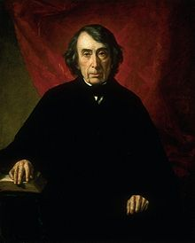
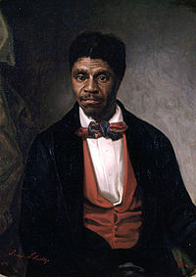
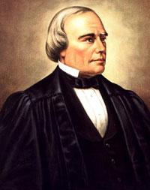
Case Study:
Dred Scott v. Sanford
The case that caused a
Civil War
Roger Taney Dred Scott Benjamin Robbins Curtis

Slide 67
Bonus Questions of the Day
For next time – Read Assignments
for Class One to Ten
Question of the Day
Questions???

