Slide 1


Slide Set Fifteen:
Real Property: Fixtures, Adverse Possession and Non Possessory Interests

Slide 2

Last Time We Spoke About:
The Following:
- The Nature, Definitions and Explanation of Estates in Land
Possessory Interests in Land
1. Fee Simple Absolute
2. Defeasible Estates
3. Fee Tail
4. Life Estate
Non possessory interests in land:
1. Easements, 2. Profits, 3. Covenants, and 4. Servitudes
- Future Interests
Future Interests - Estates in Time
1. Life Estates, 2. Possibility of Reverters, and 3. Rights of Re-Entry
- Title Limitation Rules
- Rule in Shelley’s Case
- Doctrine of Worthier Title
- Rule Against Perpetuities
- Rule Against Restraints on Alienation

Slide 3
Tonight We Will Speak About:
We Will Discuss:
- Fixtures
- Adverse Possession
- COACHEN
1. Continuous,
2. Open,
3. Actual,
4. Claim of Right,
5. Hostile,
6. Exclusive, and
7. Notorious.
- Non Possessory Interests
- Easements
- Profits
- Covenants
- Servitudes

Slide 4
Part One:
Fixtures

Slide 5

Fixtures

Slide 6
Fixtures
General Principles
A. In General:
A “fixture” is a chattel:
that has been affixed to land
and has ceased being personal property
by become part of the realty.
B. Constructive Affixation:
Certain items have been deemed to be fixtures
even if they are NOT specifically affixed.
Such items include items that were designed to go with the real property in question.
- Classic examples include Keys to doors, garage door opener controllers, area rugs especially cut for odd dimension rooms, and certain custom designed wall units.
C. Intention Standard:
The general rule when it is unknown if an item should be classified as a fixture is whether a reasonable buyer would expect
and a reasonable seller would intend
such item to be a part of the realty.

Slide 7
Fixtures
General Principles
A. Classification
  If a chattel has been categorized as a fixture,
  it is a part of the real estate.
  A conveyance of the real estate, in the absence of any specific agreement
  to the contrary, passes the fixture with it.
  As a result, the fixture, as a part of the realty,
  passes to the new owner of the real estate.
B. Mortgage
  To the extent that the owner of the real estate mortgages the realty,
  in the absence of an agreement to the contrary,
  the mortgage attaches to all fixtures on the real estate.
C. Agreement to the Contrary:
  Even though the concept of fixtures may apply and a chattel becomes a fixture, an agreement between a buyer and seller (similarly between a mortgagor and a mortgagee) can cause a severance of title.
  As a result a buyer may agree that a seller may remove certain fixtures, or a mortgagor that the lien shall not attach to the same.
  The effect of such an agreement is to de-annex, and to reconvert the fixture back to a chattel.

Slide 8

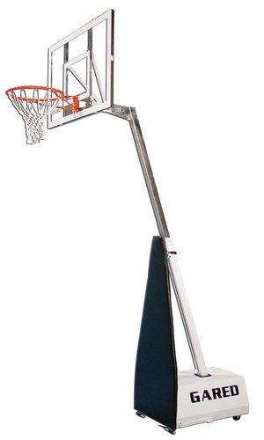
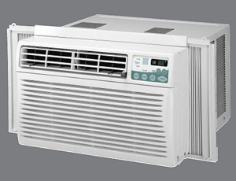
Fixtures
Challenging Items:
Flat Screen TV’s
In Room Air Conditioners
Electrical Generators
Art Collections
Screened Yard Houses
Satellite Dishes
Basketball Units

Slide 9
Part Two:
Adverse Position

Slide 10
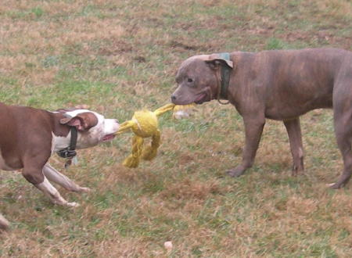
Adverse Possession

Slide 11
Adverse Possession
Generally:
STATUTE OF LIMITATIONS:
At the core of Adverse Possession is a statute of limitations
Statutes of Limitation bar law suits (the bringing of legal actions) after some period of time after the cause of action accrues.
Why a have Statutes of Limitations?
- Stale claims
- Memory of witnesses
- Plaintiff lacks seriousness
- Judicial administration
Under New York State Law (Section 212 (a) of the CPLR) the statute of limitations for an action to recover real property is 10 years (this is the time period for adverse possession).

Slide 12
Adverse Possession
Generally:
Basic Issues:
In context of actions to recover possession of real property
the cause of action accrues at the time wrongdoer enters and takes
possession of the property.
A cause of action for wrongful possession
differs from cause of action for trespass.
In trespass, there is a wrongful entry, not wrongful possession.
Underlying Policies: Why the Law Recognizes It
To reward productivity with the land
To avoid continuing, unresolved, title disputes
To penalize true owners for sitting on their rights and not protecting their land

Slide 13

Adverse Possession
Specific Requirements: C-O-A-C-H-E-N:
C-O-A-C-H-E-N

Slide 14
Adverse Possession
Specific Requirements: C-O-A-C-H-E-N:
C-O-A-C-H-E-N
Continuous
Open
Actual
Claim of Right
Hostile
Exclusive
Notorious

Slide 15
Adverse Possession
Specific Requirements: C-O-A-C-H-E-N:
1. Continuous:
Continuous for Adverse Possession purposes has been defined as:
“The uninterrupted possession of the land”.
But the possessor needn’t be present at all times
The term Continuous has further been described as:
  “The kind and frequency of the acts of occupancy, necessary to constitute continuing possession, are dependent on the nature and condition of the premises as well as the uses to which it is adapted.”
Seasonal possession can constitute continuous possession

Slide 16
Adverse Possession
Specific Requirements: C-O-A-C-H-E-N:
2. Open:
An act to adversely possess a parcel is deemed as Open:
“if it is conducted in a manner
which would put a person of ordinary prudence
on notice of the [adverse] claim”.

Slide 17
Adverse Possession
Specific Requirements: C-O-A-C-H-E-N:
3. Actual:
Actual has been defined as:
  “The use of the land as a reasonable owner would use the land -- not necessarily its highest and best use”
The Adverse Possession is viewed in terms
of the ACTUAL state of the land
Simply because a parcel may be susceptible to uses
other than those to which the claimant chose to put it
does not necessarily lead to the conclusion
that the claimant failed to act toward the parcel
as an average owner would have

Slide 18
Adverse Possession
Specific Requirements: C-O-A-C-H-E-N:
4. Claim of Right:
Claim of Right for Adverse Possession has been defined as:
“A claim of land to hold it for oneself.”
Different from Color of Title - which is any fact that would support a party’s title to a parcel of land.
With a Claim of Right:
The party “claims” the land, and
then takes possession under such action.
It can be viewed as Action v. Argument.

Slide 19
Adverse Possession
Specific Requirements: C-O-A-C-H-E-N:
5. Hostile:
Hostile for the purpose of Adverse Possession has been defined as:
“When an adverse possessor acts as if he intends
to claim the land and treat it as his own.”
Hostile is a legal concept, not an emotional one.
- This is not the same as acting with ill-will.
- Rather, an adverse possessor acts with hostility, merely
when they act as if they own the property
and maintain all the rights incumbent with such ownership.

Slide 20
Adverse Possession
Specific Requirements: C-O-A-C-H-E-N:
6. Exclusive:
Exclusive for Adverse Possession purposes has been defined as:
“The Exclusive, unshared use of the land”.
This Exclusive requirement means that the adverse possession is:
“For the sole use and enjoyment of the possessor alone,
and that such possession and use is not shared with the true owner.”

Slide 21
Adverse Possession
Specific Requirements: C-O-A-C-H-E-N:
7. Notorious:
Notorious for Adverse Possession purposes has been defined as:
“That the possession by the adverse party
is well and widely known in a public manner
forming a part of common knowledge
in the community.
Whereas the “OPEN” requirement necessitates that the true owner of the property would be on notice of the adverse possession, the “NOTORIOUS” requirement necessitates that the Community would be on notice of the actions constituting the Adverse Possession.

Slide 22
Adverse Possession
What does it mean? - Restrictions
This is a way for land to be acquired without formal conveyance
It is not with out risk or restrictions
Action can be maintained by true land owner for ejectment with damages.
New law passed last year in New York State:
(Chapter 269 of the laws of 2008) – Amending Section 501 of the Real Property Actions and Proceedings Law, to bar bad faith adverse possession claims by requiring an adverse possessor to have a reasonable basis for believing that the property belongs to the possessor.
Specifically, this law would also:
(1) Remove the traditional requirement that property be cultivated or improved, and instead requires acts sufficient to put a reasonably diligent owner on notice;
(2) Provide that lawn mowing and de minimus non-structural encroachments would be deemed permissive; and
(3) updates some archaic statutory language.

Slide 23
Part Three:
Non Possessory Interests

Slide 24
Non Possessory Interests:
Differences Between Possessory and Non Possessory Interests
Until now we have discussed “Possessory Interests”.
Possessory Interests are interests in Real Property
that either are, or will be (as in the case of pre-vested interests)
possessed by the holder of the property.
Just as there are possessory interests in Real Property
where possession is not effectuated yet,
because of time or condition,
the law also recognizes interests in Real Property
where the holder of such interest does not EVER
actually possess the Real Property.
These interests are deemed ”Non Possessory Interests”

Slide 25
Non Possessory Interests
There are Four Types of Non Possessory Interests:
Easements
Profits
Covenants
Servitudes

Slide 26
Non Possessory Interests
Types of Non Possessory Interests – Similarities and Differences
Easements, profits, covenants, and servitudes
are all Non Possessory interests in land.
They create a right to use land
that is possessed by someone else.
Easements, profits, covenants, and servitudes
have many similarities,
in operation, coverage, creation and termination.
They also have several important differences,
mainly in the requirements that must be met
for their enforcement.

Slide 27
Non Possessory Interests:
EASEMENTS
The first type of Non Possessory Interest
in Real Property is called an Easement.
An Easement is defined as:
“The right to use a tract of land for a specific purpose”.
There are Four Types of Easements:
- Affirmative
- Negative,
- Appurtenant
- In Gross.

Slide 28
Non Possessory Interests:
EASEMENTS – Just What are They?
As set forth previously,
the holder of an easement has the right to use a tract of land
(called the servient tenement) for a special purpose,
but has no right to possess and enjoy the tract of land.
The owner of the servient tenement continues to have the right of full possession and enjoyment
subject only to the limitation that he cannot interfere
with the right of special use created in the easement holder.
Typically, easements are created in order to give their holder
the right of access across a tract of land,
such as the privilege of laying utility lines,
or installing and maintaining such things as sewer pipes.
Easements are either affirmative or negative, appurtenant or in gross.

Slide 29
Non Possessory Interests:
EASEMENTS – Types of Easements
Affirmative Easements
The first type of Easement is an Affirmative Easement.
These Easements grant the holder the right to enter upon the servient tenement and make an affirmative use of it for a specific purpose.
They permit the holder to make a use of the servient estate that, absent the easement, would be an unlawful trespass or nuisance.
Examples of Affirmative Easements include:
- Laying and maintaining utility lines, draining waters, or utilizing airspace over the servient estate.
- A right-of way easement, permitting the holder to travel over the servient estate.

Slide 30
Non Possessory Interests:
EASEMENTS – Types of Easements
Negative Easements
The second type of Easement is a Negative Easement.
These Easements grant the holder
the right to PREVENT the possessory owner
from doing a specific activity with the servient tenement.
These Easements act, in effect, as a restrictive covenant.
Courts hesitate to recognize new forms of negative easements and generally have confined them to a traditional handful, such as, Easements that protect light, air, subjacent or lateral support, and the flow of water.
Examples of Negative Easements include:
- Preventing the construction of a Lake view obstructing fence or structure.
- Preventing the removal or obstruction of a local storm drainage system.

Slide 31
Non Possessory Interests:
EASEMENTS – Types of Easements
Easement Appurtenant
The third type of Easement is an Easement Appurtenant.
These Easements grant a land owner of one tract the right of special use benefits of his physical use or enjoyment of another tract of land.
For an easement appurtenant to exist, there must be TWO tracts of land:
- The dominant tenement, which has the benefit of the easement, and - The servient tenement, which is subject to the easement right.
Easements appurtenant pass with transfers of the benefited land, regardless of whether the easement is mentioned in the conveyance.
Example:
A owns Lot 6 and B owns Lot 7. These lots are adjoining tracts of land. By a written instrument (the easement appurtenant), B grants to A the right to cross B's tract (Lot 7). A's use and enjoyment of his land (Lot 6) is benefited by virtue of the acquisition of the right to use B’s land (Lot 7) for this special purpose. The right is an easement appurtenant. B remains the owner of Lot 7. A has only a right to use Lot 7 for a special purpose, (i.e., the right to cross the tract).

Slide 32
Non Possessory Interests:
EASEMENTS – Types of Easements
Easement in Gross
The fourth type of Easement is an Easement in Gross.
These Easements are created where the holder of the easement
interest acquires a right of special use in the servient tenement
independent of his ownership or possession of another tract of land.
With this Easement, the holder is not benefited in his use and
enjoyment of a possessory estate by virtue of the acquisition of
that privilege.
With an Easement in Gross, there is no dominant tenement.
An Easement in Gross passes entirely apart from any transfer of land.
Example:
A owns Lot 6. By a written instrument, he grants to B the right to build a pipeline across Lot 6.
B receives the privilege independent of his ownership or possession of a separate tract of
land. B has acquired an easement in gross. Easements in gross can be either personal (e.g.,
0 gives friend right to swim and boat on lake) or commercial (e.g., utility or railroad track
easements). Generally, an easement in gross is transferable only if the easement is for a
commercial or economic purpose.

Slide 33
Non Possessory Interests:
EASEMENTS – Types of Easements
Easements Appurtenant vs. Easement in Gross
Easements Appurtenant are given judicial preference,
If an easement interest is created and its owner holds a possessory estate that is, or could be, benefited in physical use or enjoyment by the acquisition of the privilege, the easement will be deemed appurtenant.
This is true even though the deed creating the easement makes no reference to a dominant tenement.
Example:
A conveys to "B, her heirs, successors, and assigns, the right to use a strip 20 feet wide on the north edge of Blackacre for ingress and egress to Whiteacre."
Because there is ambiguity as to whether the benefit was intended to attach to B's land, (Whiteacre) or to B personally, a court will apply the constructional preference and hold that the benefit was intended to be appurtenant.
As a result, any conveyance of Whiteacre by B will carry with it the right to use the strip across Blackacre.

Slide 34
Non Possessory Interests:
EASEMENTS – Creation of Easements
The basic methods of creating an easement are:
Express grant
Express reservation
Implication, and
Prescription.

Slide 35
Non Possessory Interests:
EASEMENTS – Creation of Easements
Express Grant:
An Easement can be created by an express grant, accomplished by the delivery of a written document, signed by the grantor.
Because an Easement is an interest in land, the Statute of Frauds applies (written instrument signed by the party to be charged).
A grant of an Easement must comply with all the formal requisites of a deed.
An Easement is presumed to be of perpetual duration unless the grant specifically limits the interest (e.g., for life, for 10 years).

Slide 36
Non Possessory Interests:
EASEMENTS – Creation of Easements
Express Reservation:
An Easement by Reservation arises when the owner (of a present possessory interest) of a tract of land conveys title but RESERVES the right to continue to use the tract for a special purpose after the conveyance.
In effect, the grantor passes title to the land but RESERVES unto himself, through the deed, an easement interest.
Note, that in most states, an Easement can only be reserved for the grantor. As a result, any attempt by the grantor to reserve an Easement for anyone else is deemed void.

Slide 37
Non Possessory Interests:
EASEMENTS – Creation of Easements
Implication:
An Easement by Implication is created by operation of law rather than by written instrument.
It is an exception to the Statute of Frauds.
There are only two types of Implied Easements:
1. An intended easement based on a use that existed when the dominant and servient estates were severed, and
2. An easement by necessity.

Slide 38
Non Possessory Interests:
EASEMENTS – Creation of Easements
Prescription:
Acquiring an Easement by Prescription is analogous to acquiring property by adverse possession.
To acquire a Prescriptive Easement, the use of the Easement must be continuous, open, actual, under a claim of right, hostile and notorious. Since Easements by their nature are upon non possessed lands, exclusivity does not apply.
The public at large can acquire a Prescriptive Easement in private land if members of the public use it in a way that meets the requirements for prescription.
Negative easements cannot arise by prescription, nor generally may easements involving public lands.
An easement by necessity cannot give rise to an easement by prescription. However. if the necessity ends, so does the easement, and an adverse use can, over time, create an easement by prescription.

Slide 39
Non Possessory Interests:
EASEMENTS – Termination of Easements
An easement, like any other property interest, may be created for a duration of perpetuity or for a limited period of time.
To the extent the parties to its original creation provide for the natural termination of the interest, such limitations will control.
Release - An easement may be terminated by a release given by the owner of the easement interest to the owner of the servient tenement. A release requires the concurrence of both owners, and is, in effect, a conveyance. The release must be executed with all the formalities that are required for the valid creation of an easement. It must be in writing in order to satisfy the Statute of Frauds. An oral release is ineffective, although it may become effective by estoppel.
Abandonment - It has become an established rule that an easement can be extinguished without conveyance where the owner of the privilege demonstrates by physical action an intention to permanently abandon the easement. To work as an abandonment, the owner must have manifested an intention never to make use of the easement again.

Slide 40
Non Possessory Interests:
PROFITS – Generally:
A Profit, like an Easement, is a nonpossessory interest in land.
A Profit is a commercial relationship in real property whereby:
“The holder of the Profit is entitled
to enter upon the servient tenement to which the profit applies,
and take the soil or a substance of the soil from the real property”
Profits usually involve minerals, timber, oil, or game.
A Profit may also be appurtenant or in gross.
Unlike Easements, however, there is a constructional preference for Profits in gross rather than appurtenant.

Slide 41
Non Possessory Interests:
PROFITS – Elements:
1. Creation - Profits are created in the same way as easements.
2. Alienability - A profit appurtenant follows the ownership of the dominant tenement and a profit in gross may be assigned or transferred by the holder.
3. Exclusive vs. Nonexclusive Profits - Profits may be granted for exclusive use by the grantee, or non exclusive use for the grantee and others. Ordinarily, profits (like easements) are construed as nonexclusive.
4. Scope - The extent and nature of the profit is determined by the words of the express grant (if there was a grant), or by the nature of the use (if the profit was acquired by prescription). Implied in every profit is an easement entitling the profit holder to enter the servient estate to remove the resource.
5. Termination - Profits are terminated in the same way as easements.

Slide 42
Non Possessory Interests:
COVENANTS – Generally:
A Covenant Running With The Land at Law is defined as:
“A written promise (normally found in a deed) to do something on the land or a promise not to do something on the land”.
A covenant, normally found in deeds, is a written promise to do something on the land (e.g. maintain a fence) or a promise not to do something on the land (e.g., conduct commercial business).
Covenants run with the land at law, which means that subsequent owners of the land may enforce or be burdened by the covenant.
To run with the land, however, the benefit and burden of the Covenant must be analyzed separately to determine whether they meet the requirements for running.

Slide 43
Non Possessory Interests:
COVENANTS – Termination:
As with all other nonpossessory interests in land, a Covenant may be terminated by:
(i) the holder of the benefit executing a release in writing;
(ii) merger (fee simple title to both the benefited and burdened land comes into the hands of a single owner); and
(iii) condemnation of the burdened property.

Slide 44
Non Possessory Interests:
EQUITABLE SERVITUDES – Generally:
An Equitable Servitude is defined as:
“A Covenant that, regardless of whether it runs with the land at law, will be enforced in equity against the assignees of the burdened land who have notice of the covenant”.
The usual remedy for a violation of an Equitable Servitude is specific performance of the covenant, or an injunction against its violation.
Creation
Generally, Equitable Servitudes are created by covenants contained in a writing that satisfies the Statute of Frauds.
As with Covenants, acceptance of a deed signed only by the grantor is sufficient to bind the grantee as promisor.
Enforcement
For successors of the original promisee and promisor to enforce an Equitable Servitude, certain requirements must be met (Running).

Slide 45
Non Possessory Interests:
EQUITABLE SERVITUDES – Generally:
Requirements for Burden to Run with the Land:
1) Intent - The covenanting parties must have intended that the Equitable Servitude be enforceable by and against assignees.
Such intent may be ascertained from the purpose of the Covenant and the surrounding circumstances.
2) Notice - A subsequent purchaser of land burdened by a Covenant is not bound by it in equity unless he had actual or constructive notice of it when he acquired the land.
3) Touch and Concern – As with covenants, the restriction of the Equitable Servitude must directly involve and concern the real property.
When the Benefit Will Run - The benefit of the Equitable Servitude will run with the land (and thus to successors in interest) if the original parties so intended and the servitude touches and concerns the benefited property.
Privity Not Required – Most courts now enforce the Servitude not as an in personam right against the owner of the servient tenement, but as an equitable property interest in the land itself. There is, therefore, no need for privity of estate.

Slide 46
Non Possessory Interests:
EQUITABLE SERVITUDES – Generally:
Equitable Defenses to Enforcement:
A court in equity is not bound to enforce an Equitable Servitude if it cannot in good conscience do so. Defenses include:
a. Unclean Hands
b. Acquiescence
c. Estoppel
d. Changed Neighborhood Conditions
e. Zoning
Termination:
Like other nonpossessory interests in land, an Equitable Servitude may be terminated by:
1. A written release from the benefit holder(s),
2. Merger of the benefited and burdened estate, or
3. Condemnation of the burdened property.

Slide 47
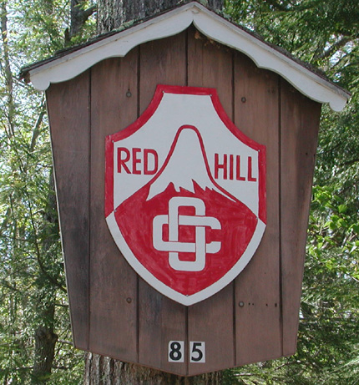
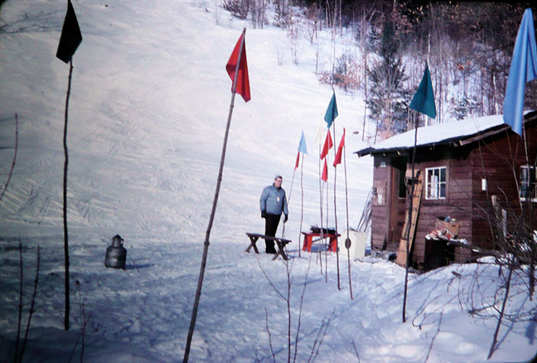
Class Exercise:
The Case of the Ski-slope
The Club and the Rope Tow

Slide 48
Bonus Questions of the Day
For next time – Read Assignments for Classes One to Twelve on the Webpage.
Questions???

