Slide 1
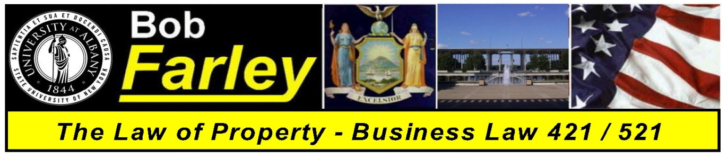

Slide Set Eight:
Intellectual Property
Patents, Trademarks and Copyrights

Slide 2

Last Class – We Spoke About:
Personal Property: A Continuation of Rights, Ownership, Possession and Transfers:
- Gifts
- Gifts Intervivos and Gifts Causa Mortis
- Requires: Intent, Delivery and Acceptance
- Liens
- General Liens and Special Liens
- Can only be given by owner of the property
- Bailments and Special Interests.
- DAPPER: Delivery, Agreement, Personal property, for a Purpose,
Entered into for the benefit of one or both parties, and
ended with Redelivery
- Level of Care – Dependent upon whose benefit the bailment is for.

Slide 3
Tonight’s Class:
We will discuss Intellectual Property Concepts
- Patents
- Trademarks and
- Copyrights; and

Slide 4
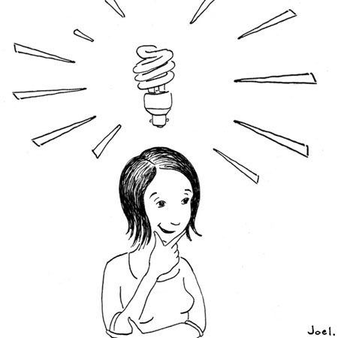
Intellectual Property
Not all property is tangible
This is why we need to think of property in terms of “rights” not “things”.
This concept becomes especially important for
intellectual property.

Slide 5
Intellectual Property
Rights in Ideas: Although common law was reluctant to invest property rights in an “idea”, modern society and law have evolved property rights to include certain unique intellectual designs, processes or works.
Federal Law Governs: Although most property law is state law, virtually all intellectual property law is based upon federal statutes.

Slide 6
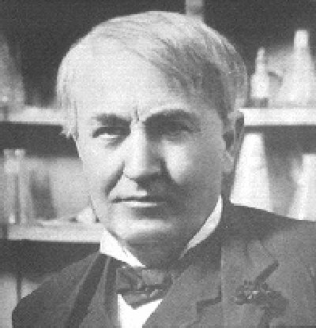
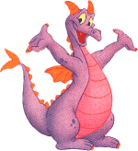

Intellectual Property
It all starts with an idea!

Slide 7
Intellectual Property
Intellectual Property Defined: Any product of human intellect that is intangible but has value in the marketplace. It is called “intellectual” property because it is the product of human imagination, creativity, and inventiveness.
Why It is Important:
  Traditionally, businesses have thought of their physical assets, such as land, buildings, and equipment as the most important. Increasingly, however, a company’s intellectual assets are the most important. Protecting intellectual property, promotes creativity, invention and provides incentive and rewards for hard work.

Slide 8
Intellectual Property
Rights in Ideas: Although common law was reluctant to invest property rights in an “idea”, modern society and law have evolved property rights to include certain unique intellectual designs, processes or works.
Federal Law Governs: Although most property law is state law, virtually all intellectual property law is based upon federal statutes.

Slide 9
Intellectual Property
Three Types of Intellectual Property:
Patents – Ideas for Products or Processes
Trademarks – Logos, Identifications or Distinctions
Copyrights – Written or Performed Works

Slide 10
Intellectual Property
Part One:
Copyrights
Enforceable Rights in Writings, Art or Expression

Slide 11

Intellectual Property
Copyrights – Rights in Writings, Art or Expression
Defined as “Original works of authorship fixed in any tangible medium of expression”.
Key Elements
1. Originality (Uniqueness)
2. Work of Authorship
    ● Literary,
    ● Music,
    ● Dramatic,
    ● Graphic or Architectural, or
● Movies or Audio Production
*Software is viewed as literary
3. Fixation (Any physical rendering)

Slide 12
Intellectual Property
Copyrights
Collection of Rights – Including the right to:
Prevent Reproduction
Create derivative works
Distribute Copies
Perform, display or transmit the Work Publicly
Duration of Rights:
If created after 1978 - Life of the author plus 70 years (No renewal)
If created before 1978 – 28 years plus a renewal for 47 years (75 years)
Work for Hire Exception – 95 years from publication or 120 from creation whichever is less.

Slide 13
Intellectual Property
Copyrights
To prove Infringement – A Plaintiff Must:
1. Hold a valid copyright
2. The defendant copied the work; and
3. The copy was inappropriate appropriation (Two works are substantially similar)
Defenses: Agreement or Fair Use – Protecting the Copyright and protecting the minimal use and free speech rights of the user.
Remedies: Injunction, Impoundment and Destruction, and Damages

Slide 14
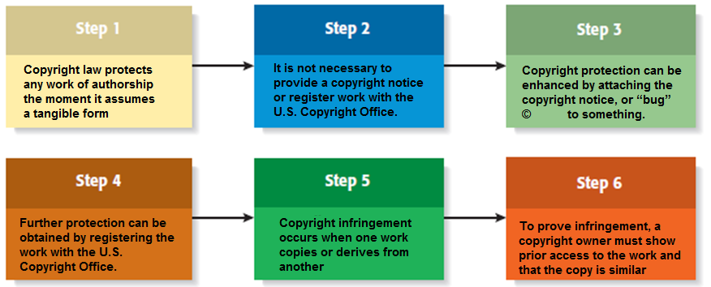
Intellectual Property
Copyrights
The Process of Obtaining a Copyright

Slide 15
Intellectual Property
Part Two:
Patents
Enforceable Rights in any new or useful process, machine, manufacture, composition of matter, or improvement.

Slide 16
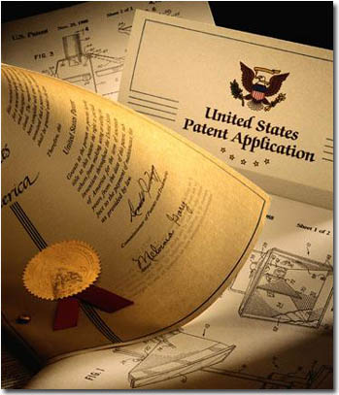
Intellectual Property
Patents
The intellectual property rights vested
in anyone who “invents or discovers
any new or useful process, machine,
manufacture, or any composition
of matter, or any new or useful
improvement thereof.”
Four Elements:
1. Patentable subject matter
2. Utility
3. Novelty; and
4. Non-obviousness

Slide 17
Intellectual Property
Patents
1. Patentable Subject Matter
● Process:
An act, or a series of acts or steps (such as a
mode of treatment of certain materials) to
produce a given result.
● Machine:
A concrete thing, consisting of parts, or of
certain devices and combination of devices.
● Manufacture
An article produced from raw or prepared materials by giving to these
materials new forms, qualities, properties, or combinations, whether by
hand labor or by machinery.
● Composition of matter
All compositions of two or more substances and all composite articles,
whether they be the results of chemical union, or of mechanical mixture, or
whether they be gases, fluids, powders or solids.

Slide 18
Intellectual Property
Patents
2. Utility
The Invention must be useful
and provide actual benefit
3. Novelty
The Invention must new, novel
and unique.
4. Non-obviousness
The Invention must not be obvious
to a person of ordinary skill in the
subject area.

Slide 19
Intellectual Property
Patents
Collection of Rights
- The Right to prevent others from
making, using or selling the invention.
- A patent is federal right with no rights
directly transferable outside the US.
- Must file the patent in every nation
in which they wish to protect.
2. Duration of Rights
- 20 years from the date the patent is filed
- Nonrenewable and require a maintenance fee to the PTO.

Slide 20
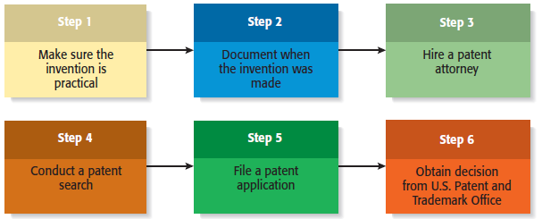
Intellectual Property
Patents
The Process of Obtaining a Patent

Slide 21
Intellectual Property
Part Three:
Trademarks
Enforceable Rights in any word, name, symbol or devise.

Slide 22

Intellectual Property
Trademarks
A trademark is any “word, name, symbol or devise used by a person to identify and distinguish their goods from those sold by others”
Requirements:
Distinctiveness
Non-functionality
First use in trade
Duration – Good for 10 years with infinite renewals

Slide 23

Intellectual Property
Trademarks
MULTIFACTED TRADEMARK PROTECTION
Name is trademarked
Symbol is trademarked
Slogan is trademarked

Slide 24
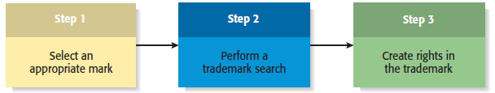
Intellectual Property
Trademarks
The Process of Obtaining a Trademark

Slide 25

Registration and Recording
Where, When and How
● US Patent and Trademark Office
Washington DC
● Practice before it and the Federal
Courts requires admission to a
separate bar
● Can clerk at the office and
don’t have to even be a lawyer.

Slide 26
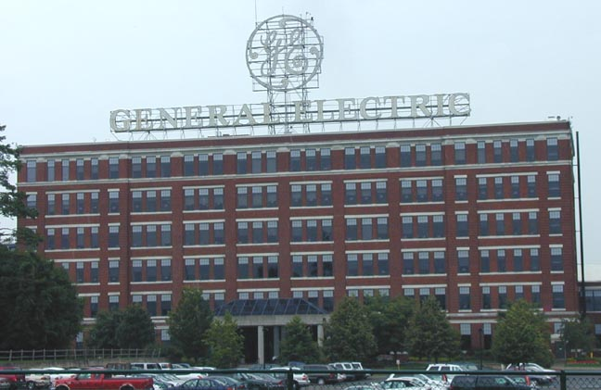
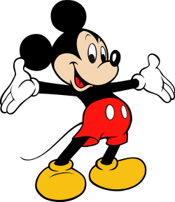

Modern Trends
The World of Intellectual Property
Concerns over China – Reverse Engineering
Especially big issues with items uniquely
Intellectual – music, software, processes
Big players
General Electric
Disney
Motion Picture Companies

Slide 27
Bonus Questions of the Day
For next time – Read Assignments
on the Website
Questions???

