Slide 1


Slide Set Fourteen:
Real Property: Estates in Land
Interests in Land – Future Interests

Slide 2

Last Class:
We Discussed:
- The Nature, Definitions and Explanation of Estates in Land
Possessory Interests in Land
1. Fee Simple Absolute
2. Defeasible Estates
3. Fee Tail
4. Life Estate

Slide 3
Tonight’s Class:
We Will Discuss:
- The Nature, Definitions and Explanation of Estates in Land
- Future Interests
Future Interests - Estates in Time
1. Life Estates,
2. Possibility of Reverters, and
3. Rights of Re-Entry

Slide 4

Future Interests

Slide 5
Future Interests - Estates in Time
- Life Estates
The remainder is the estate in time.
- Possibility of Reverters
The reversion is the estate in time.
- Rights of Re-Entry
The right of re-entry is the estate in time.

Slide 6
Future Interests – Estates in Time
Like all property, interests in land are a collection of rights
Interests in Land need to be seen through the prism of:
  Possession
  Time
Two Major Questions
Possession – Does the interest allow possession of the realty?
Time – What time will the interest in the property be executed?
This time factor is the critical question
when dealing with “Future Interests”

Slide 7
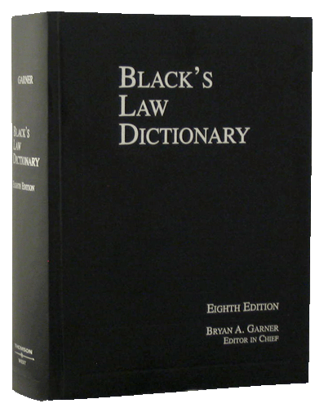
Future Interests – Estates in Time
Remember – We need to think of possession & time
Black’s Law Dictionary – Definition
Future Interests: “Interests in land or other things in which the privilege of possession or of enjoyment is future or non present.”
The real property rights that are left over from the granting of an interest

Slide 8
As a result …
Possessory Interests in Land
Can be:
Present Possessory Interests or
Future Interests

Slide 9
Estates in Land
So just how are Future Interests Determined?
A Two Step Dance: Possession and Time
(Two Major Questions – Must be asked to determine the Interest)
Step One: Form of Possession
(Possession – Does the interest allow possession of the realty?)
● Possessory Interests in Land (Either presently or in the future)
● Non - Possessory Interests in Land (Either presently or in the future)
Step Two: When the Interest Vests
● Present Interests (When the RIGHT to possess is NOW)
● Future interests (When the RIGHT to possess is in the future)

Slide 10
Types of Future Interests
Reversionary Interests
    Reversions
    Possibility of Reverter
    Right of Re-entry
Remainders

Slide 11
Explanations of Future Interests
Reversionary Interests
  Reversion
  The residue (or future interest) of an estate left by operation of law in the grantor or his heirs.
  Examples/Explanation:
  When any lesser estate is created from the fee simple absolute, the reversion is legal rights in the estate that the grantor or his heirs are entitled to after such creation, including remainders or executory interests, vesting in the grantor of his heirs. The key is that such legal interest RETURNS to the grantor or his heirs.

Slide 12
Explanations of Future Interests
Reversionary Interests
  Possibility of Reverter
  A specific type of reversion, pursuant to a fee simple determinable, whereby the estate AUTOMATICALLY returns to grantor of his heirs upon the happening of a stated, legal, event.
  Examples/Explanation:
  When a grantor transfers an estate to the grantee for so long as the property remains an active, cultivated farm, if the grantee stops using such property for such legal purpose, the parcel automatically reverts back to the grantor or his heirs.

Slide 13
Explanations of Future Interests
Reversionary Interests
  Right of Re-entry
  A specific type of reversion, pursuant to a fee simple subject to a condition subsequent, whereby the grantor or his heirs have a right to reclaim the estate upon the happening of a stated, legal, event.
  Examples/Explanation:
  When a grantor transfers an estate to the grantee upon the condition that the property remains an active, cultivated farm, if the grantee stops using such property for such legal purpose, then the grantor or his heirs can exercise a right to reclaim full title to the parcel.

Slide 14
Explanations of Future Interests
Remainders
  Remainder
  The remnant (or future interest) of an estate depending upon a particular prior estate created at the same time and by the same instrument, and limited to arise immediately on the determination of that estate, and not in abridgement of it. In other words, a remainder is a future interest limited in favor of a transferee, which may become possessory immediately upon the termination (upon the happening of a limitation) of a prior possessory estate simultaneously created
  Examples/Explanation:
  Those rights in an estate which are left over (i.e. that remain) from the creation of a lesser estate.

Slide 15
Explanations of Future Interests
Remainders
  Remainders v. Reversions
  Reversions are special remainders, whereby the remainder vests in the grantee or his heirs. As a result, all reversions are remainders, but NOT all remainders are reversions.
  Examples/Explanation:
  In the case of a reversion, the remainder is those rights in an estate which are left over (i.e. that remain) from the creation of a lesser estate and vest in the grantor of his heirs. In a remainder that is not a reversion, such is where such rights vest in another person who is NOT the grantor or his heirs.

Slide 16
For next time – Read Assignments on the Webpage
Questions???

