Slide 1


Slide Set Seventeen:
Real Property: Fixtures

Slide 2

Last Time We Spoke About:
The Following:
- The Nature, Definitions and Explanation of Estates in Land
Possessory Interests in Land
1. Fee Simple Absolute
2. Defeasible Estates
3. Fee Tail
4. Life Estate
Non possessory interests in land:
1. Easements, 2. Profits, 3. Covenants, and 4. Servitudes
- Future Interests
Future Interests - Estates in Time
1. Life Estates, 2. Possibility of Reverters, and 3. Rights of Re-Entry
- Title Limitation Rules
- Rule in Shelley’s Case
- Doctrine of Worthier Title
- Rule Against Perpetuities
- Rule Against Restraints on Alienation

Slide 3
Tonight We Will Speak About:
We Will Discuss:
- Fixtures

Slide 4
Fixtures

Slide 5

Fixtures

Slide 6
Fixtures
General Principles
A. In General:
A “fixture” is a chattel:
that has been affixed to land
and has ceased being personal property
by become part of the realty.
B. Constructive Affixation:
Certain items have been deemed to be fixtures
even if they are NOT specifically affixed.
Such items include items that were designed to go with the real property in question.
- Classic examples include Keys to doors, garage door opener controllers, area rugs especially cut for odd dimension rooms, and certain custom designed wall units.
C. Intention Standard:
The general rule when it is unknown if an item should be classified as a fixture is whether a reasonable buyer would expect
and a reasonable seller would intend
such item to be a part of the realty.

Slide 7
Fixtures
General Principles
A. Classification
  If a chattel has been categorized as a fixture,
  it is a part of the real estate.
  A conveyance of the real estate, in the absence of any specific agreement
  to the contrary, passes the fixture with it.
  As a result, the fixture, as a part of the realty,
  passes to the new owner of the real estate.
B. Mortgage
  To the extent that the owner of the real estate mortgages the realty,
  in the absence of an agreement to the contrary,
  the mortgage attaches to all fixtures on the real estate.
C. Agreement to the Contrary:
  Even though the concept of fixtures may apply and a chattel becomes a fixture, an agreement between a buyer and seller (similarly between a mortgagor and a mortgagee) can cause a severance of title.
  As a result a buyer may agree that a seller may remove certain fixtures, or a mortgagor that the lien shall not attach to the same.
  The effect of such an agreement is to de-annex, and to reconvert the fixture back to a chattel.

Slide 8

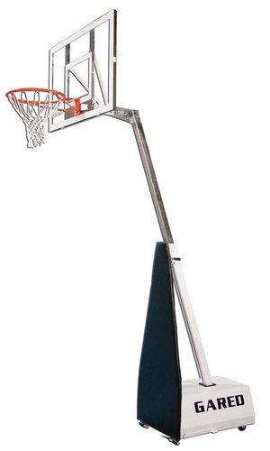
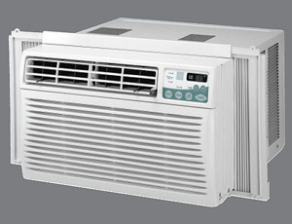
Fixtures
Challenging Items:
Flat Screen TV’s
In Room Air Conditioners
Electrical Generators
Art Collections
Screened Yard Houses
Satellite Dishes
Basketball Units

Slide 9
For next time – Read Assignments on the Webpage.
Questions???

