Slide 1
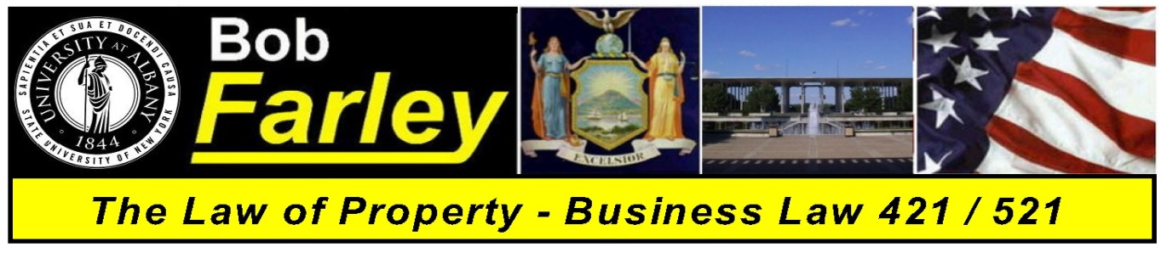

Slide Set Twenty-One:
Real Property
Modern Challenges in Property Law – Land Use

Slide 2
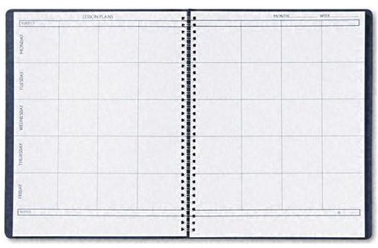
Last Time We Spoke About:
- Conveyances
- CMDR
1. Contract,
2. Mortgage,
3. Deed, and
` 4. Recording
- Who Wants to Be a Homeowner

Slide 3
Tonight We Will Speak About:
- The Value of Title Searches
- The Wonderful World of Land Use – Part One
- The Law of Nuisance
- Government Control vs. Personal Property Rights

Slide 4
Real Property – Issue of Title
The Value of Title Searches
A purchaser can only get the property rights of the seller
Title searches identify the property rights the seller has
Title searches prevent mistakes like the Creamery Bldg.
Title searches make the buyer eligible for title insurance
Title insurance guarantees rights found in title searches
Title searches help the buyer know what they purchase

Slide 5
The Law of Land Use
Nuisance
Trespass
Zoning and Planning
Governmental Taking (Eminent domain)

Slide 6
Nuisance
The law has long recognized the concept that one must not use one’s property to injure another’s property. When this type of conduct occurs it can legally be classified as Nuisance.
Private Nuisance – A private nuisance is the substantial interference with private rights to use and enjoy land, produced by either intentional and unreasonable conduct, or by unintentional conduct that is either negligent, reckless, or so inherently dangerous that strict liability is applied.
Public Nuisance – A Nuisance that affects the rights held in common by many landowners, i.e. the public, rather than the specific rights of an individual, targeted landowner can be classified as a public nuisance.

Slide 7
Nuisance
Unlike Trespass which involves a physical invasion of a person’s land, i.e. an interference with a person’s exclusive right of possession, Nuisance involves an interference, usually by instrumentality, with a person’s right to use and enjoy their land.
Examples:
Private Nuisance – An adjoining land owner decides to open a vehicle repair shop next to an organic gardener. Each day, due to numerous oil changes, oil spills from the repair shop property onto the garden, leaching into the garden’s soil. The owner of the garden would have an action in private nuisance against the owner of the repair shop.
Public Nuisance – A cement plant lawfully discharges chemicals from its smokestacks, which causes cement particles to land all over the homes and yards of an adjacent town. Because the town’s residents’ health and safety might be seen as being adversely affected, the town could maintain an action in public nuisance against the owner of the cement factory.

Slide 8
Nuisance
Remedies for nuisance include remedies at law and equity or both. As a result, a party who has suffered a nuisance can bring an action for:
* Money Damages;
* Injunction (to have the person creating the nuisance cease creating it); or
* Both

Slide 9
For next time – Read Assignments on the Webpage.
Questions???

