Slide 1
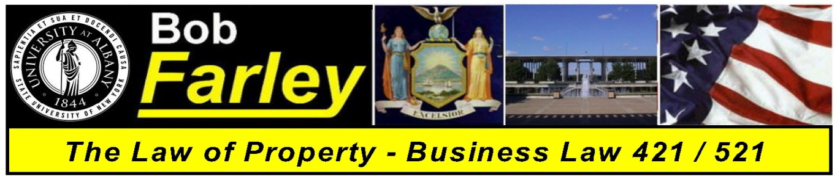

Slide Set Twenty-Two:
Real Property
Modern Challenges in Property Law – Land Use

Slide 2

Last Time We Spoke About About:
- The Value of Title Searches
- The Wonderful World of Land Use – Part Two
- The Trespass
- The Ultimate Expression of Personal Property Rights

Slide 3
Tonight We Will Speak About:
- The Wonderful World of Land Use
- The Law of Zoning; and
- The Law of Eminent Domain and Takings
- Governmental Interests vs. Personal Property Rights

Slide 4
Zoning
Zoning is the use of governmental power to regulate land use.
Zoning laws divide a political jurisdiction into specific separate geographic areas and impose limits on the permissible uses of land within each area.
Zoning has several legitimate objectives:
(1) To prevent incompatible uses from occurring (thus reducing the need for nuisance law),
(2) to increase property values generally by minimizing use conflicts (thus increasing the property tax base). and
(3) to channel development into patterns that may serve larger social goals (e.g., reduce urban sprawl to conserve resources and reduce air pollution from automobiles).
Zoning is the use of public power to impose uniform results that might otherwise be accomplished in more piecemeal and selective fashion by private bargains.

Slide 5
Zoning
Zoning limits the use that may be made of property. Usually an area is zoned for a particular use (such as commercial, industrial, agricultural, residential.
Zoning is usually done at the local level, pursuant to authority conferred by a state enabling act.
Zoning must comply with the enabling act. the state and federal constitutions. and all other state or federal laws that limit zoning power.
Some zoning laws are cumulative, meaning that in an area zoned for the least favored use all other uses are permitted, but in an area zoned for the most favored use only that use is permitted. Other zoning laws are mutually exclusive.
Zoning laws may address many specific land uses such as density. aesthetics, or household composition.
Zoning laws. when enacted, restrict or prohibit some prior lawful uses. To avoid challenges to the validity of the newly imposed regulation, zoning laws typically permit nonconforming uses to continue for a limited period of time. If an owner discontinues the use, however, it generally may not be renewed.
Zoning laws typically confer some discretion on a zoning board. When abuses of discretion occur, such rulings are deemed invalid.

Slide 6
Zoning
Variances from zoning can permit otherwise prohibited uses or deviations from density or area controls. Zoning variances are granted only to alleviate undue hardships not of the applicant's creation.
Exceptional uses are permitted by the zoning law under flexible criteria specified in the law.
Zoning amendments present the problem of spot zoning, an amendment that confers benefits on a discrete parcel without any public benefit, and often in disregard of the comprehensive use plan that zoning is supposed to implement.
Floating zones are uses that are not tethered to a specific area - the zoning board decides when the use becomes relevant where it should be located.
Contract or conditional zoning involves a change in zoning conditioned upon imposition of a
servitude restricting use that is designed to produce public benefits.
Constitutional and statutory law impose limits on the zoning power. Zoning for aesthetic purposes is generally permitted, particularly when it upholds property values.
When zoning restricts free speech it is presumed void and the government has a heavy burden of justification.
Zoning that restricts the ability of people related by blood or marriage to live together is presumed void, while zoning that restricts the ability of unrelated people to live together is presumptively valid.

Slide 7
Eminent Domain
TAKINGS: THE POWER OF EMINENT DOMAIN AND REGULATORY TAKINGS
The power of eminent domain is the power of a governmental body to take private property for public purposes.
The law places the particular focus upon the regulator. Eminent domain takings, pursuant to the United States Constitution, requires just compensation. These constitutional requirements apply to all governments and protects all forms of property.
The public use requirement is satisfied so long as there is a conceivable public purpose fur the taking.
A taking occurs whenever a regulation permanently dispossesses an owner or prevents their use and enjoyment of the property.
Compensation for the taking must be the market value of the property.
The amount of compensation is the current market value not the value that will occur due to the public improvement. Compensation is required for regulations that constitute takings, no matter how long or short the regulation may endure.

Slide 8
Eminent Domain
The Takings Clause
All governments in the United States have the power to take private property for public purposes, but that power (the eminent domain power) is limited by the U.S. Constitution, state constitutions, state statutes and judicial decisions.
The U.S. Constitution's Fifth Amendment specifically provides that "private property [shall not] be taken for public use without just compensation.“ This is called the "takings clause" or the “eminent domain" clause.
These requirements protect all property and applies to all governments.
The takings clause serves two important and related purposes.
1. Prevent forcible redistribution of property
2. Takings permitted only for public benefit

Slide 9
Eminent Domain
The meaning of public use
A literal reading of the Constitution's text
would limit governmental power
to take private property to instances
where the property will actually be used
by the public (e.g., as a park. school. road,
or military base).
The question becomes pronounced
when seizures are designed to produce
some collateral public benefit.

Slide 10
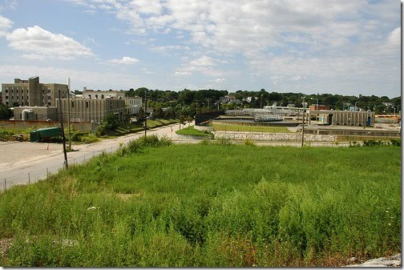
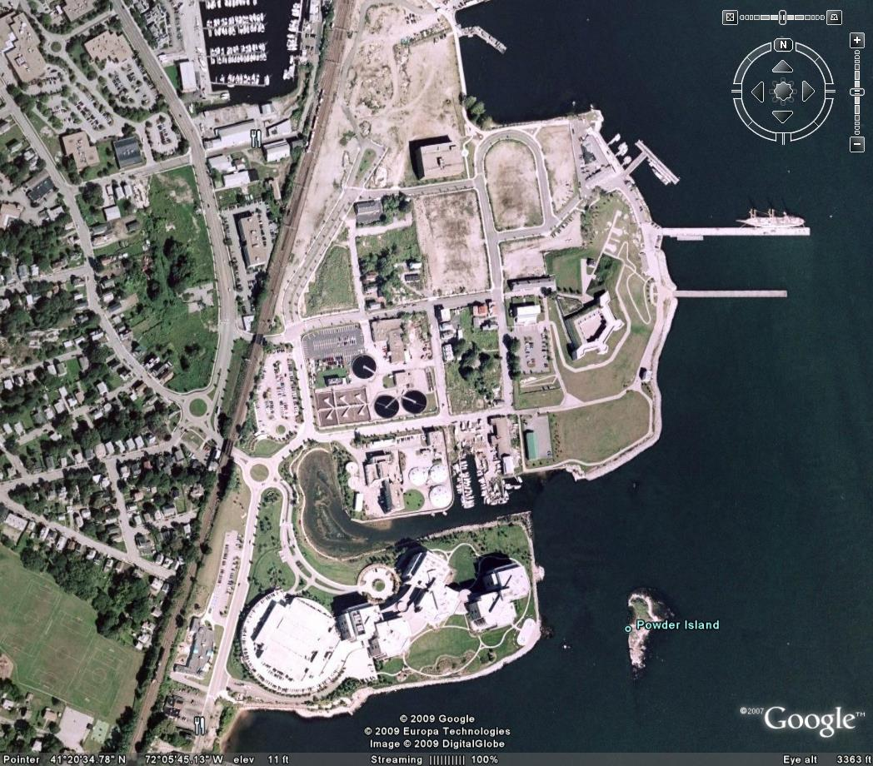

The Case of Economic Development and Urban Renewal
-v-
Individual Property Rights
The Famous Kelo Decision

Slide 11
For next time – Read Assignments on the Webpage.
Questions???

